Slide 1
OWASP Software Assurance Maturity Model (SAMM)
Sebastien Deleersnyder
SAMM Project Team
September 2019

Slide 2
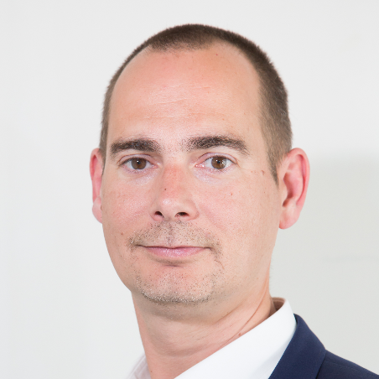
Sebastien Deleersnyder
CEO Toreon
Belgian OWASP chapter founder
SAMM project co-leader

Slide 3

What is SAMM?
The prime maturity model for software assurance that provides an effective and measurable way for all types of organizations to analyze and improve their software security posture.
Notes:
What is SAMM?
SAMM about trying to help you structure what you have/are doing and build a plan for how to improve software security
SAMM was defined with flexibility in mind such that it can be utilized by small, medium, and large organizations using any style of development. Additionally, this model can be applied organization-wide, for a single line-of-business, or even for an individual project.
SAMM is full of useful resources that will help with evaluating an organization's current practices, recommendations or suggestions for growing and maturing those practices, providing a way to demonstrate concrete improvements, and defining and measuring security activities throughout the lifecycle.
One of the big benefits of SAMM is that it is vendor agnostic.
SAMM can be done in-house or you can have one of several appsec consulting firms help you with the assessment, goals, plans, roadmaps, etc.

Slide 4



Why SAMM?
Measurable
Defined maturity levels across business practices
Actionable
Clear pathways for improving maturity levels
Versatile
Technology, process, and organization agnostic
Notes:
I like this quote from George Box, who has been called one of the great statistical minds of the 20th century.
<quote>
The point is that you can’t find a model that will exactly describe reality, there too many variables. Models are built in the academic world, we live in the real world.
But, you can have a model that is close enough to be useful, and that is what SAMM is.

Slide 5
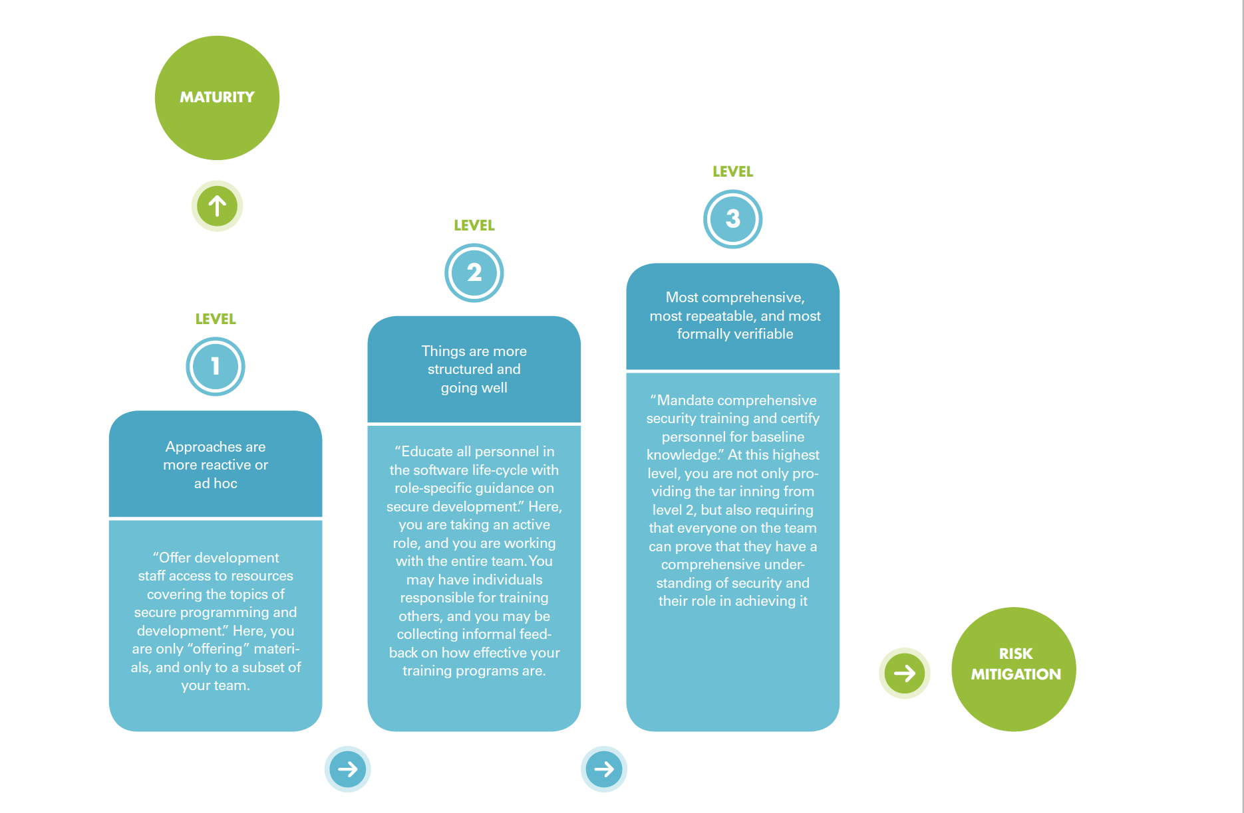
How to use SAMM?
Notes:
Quick Start Guide

Slide 6
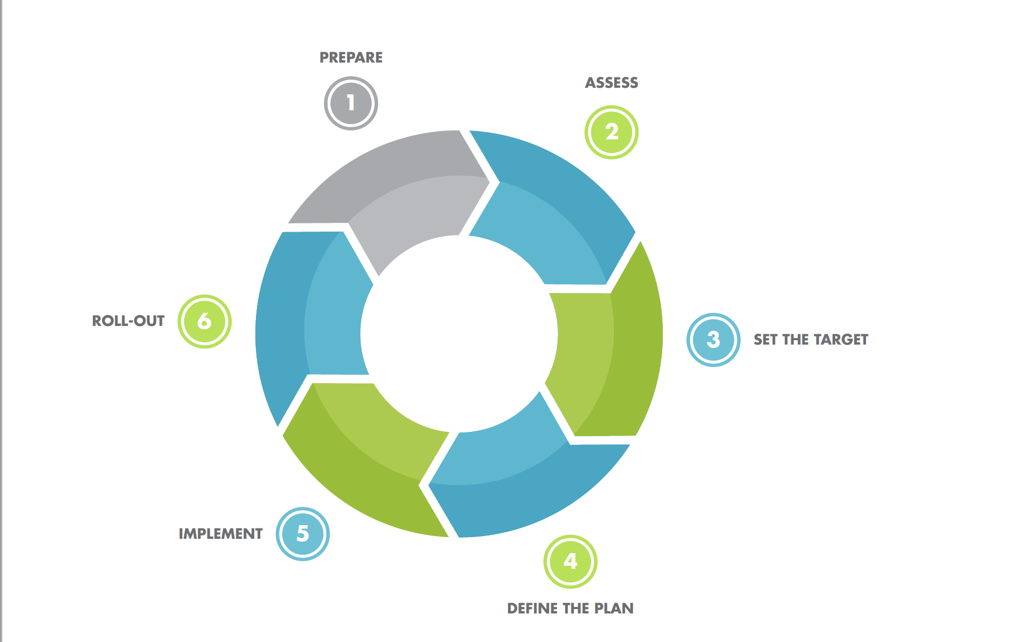
How to use SAMM?
Notes:
Quick Start Guide

Slide 7
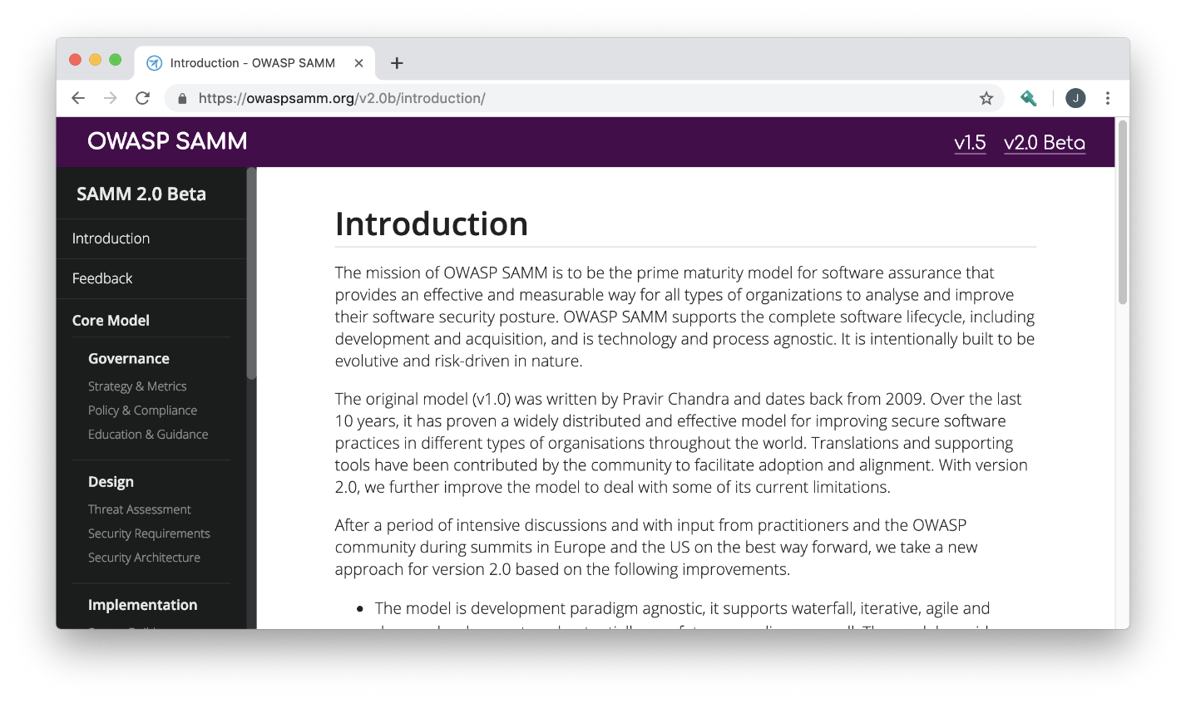
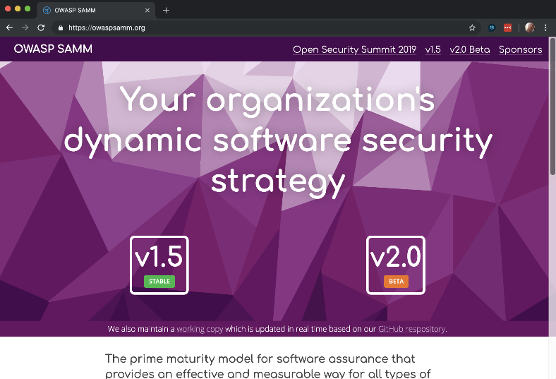
Owaspsamm.org and toolbox demo
Notes:
Let’s walk through demo of owaspsamm.org website and the SAMM toolbox.

Slide 8
Questions? Feedback? Input?
#project-samm
github.com/OWASP/samm

Slide 9



Thank You to Our Sponsors
Notes:
Thank you to our Sponsors. There are more Sponsorship opportunities still available! Please contact us if you would like to be a project sponsor.

Slide 10
SAMM newsletter
eepurl.com/gl9fb9

Slide 11
Thank you
info@owaspsamm.org

